Slide 1


Progress Update on
INSIGHTPRO
Presentation Quality Checker

Slide 2


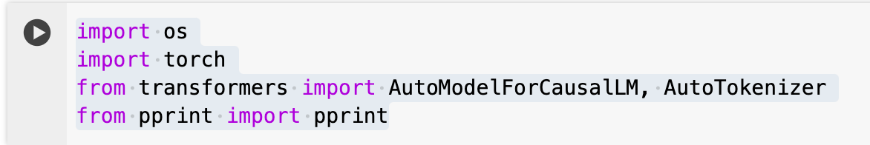
WHAT HAVE WE ACHIEVED YET ?
We know for sure we can install necessary library
And import modules that we need.

Slide 3
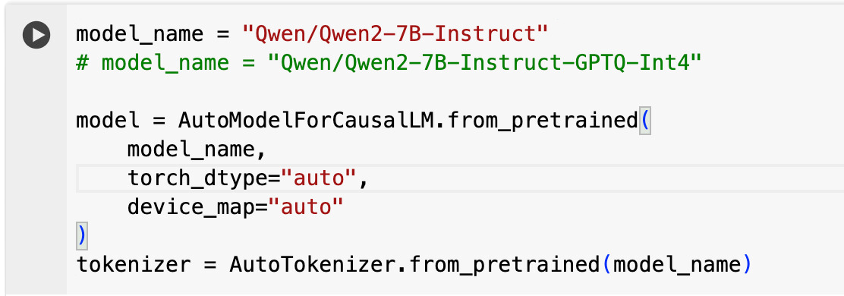
WHAT HAVE WE ACHIEVED YET ?
The code that finished my Internet Quota

Slide 4
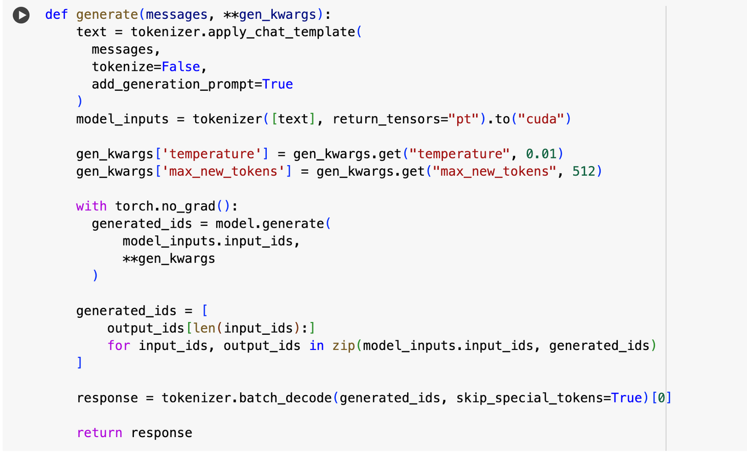
WHAT HAVE WE ACHIEVED YET ?
We will use this function as if our life depends on it, you will see.

Slide 5
WHAT HAVE WE ACHIEVED YET ?
We later realized that, Oh we forgot to upload the PPT!

Slide 6
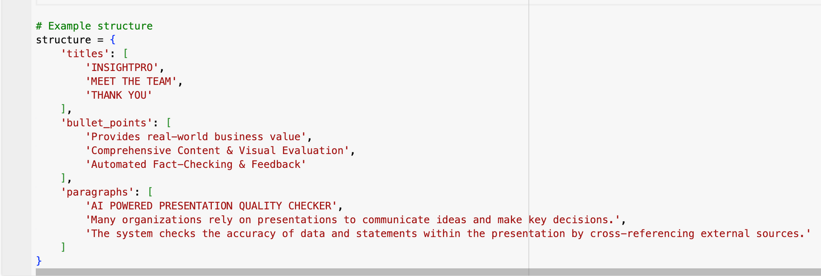
WHAT HAVE WE ACHIEVED YET ?
Once we realised that our computer is not frozen, It is just the content of structure extracted from our PPT is too large for our model to handle, we created a dummy structure

Slide 7
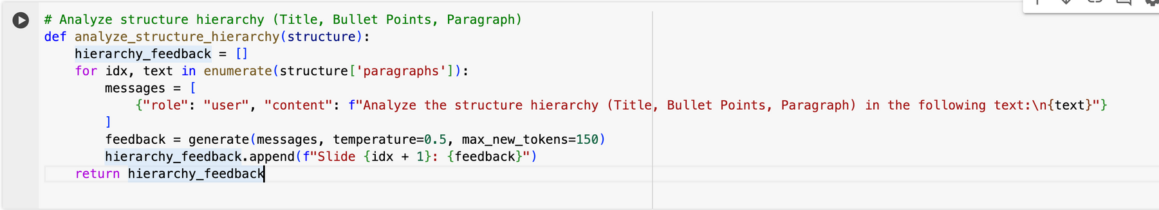
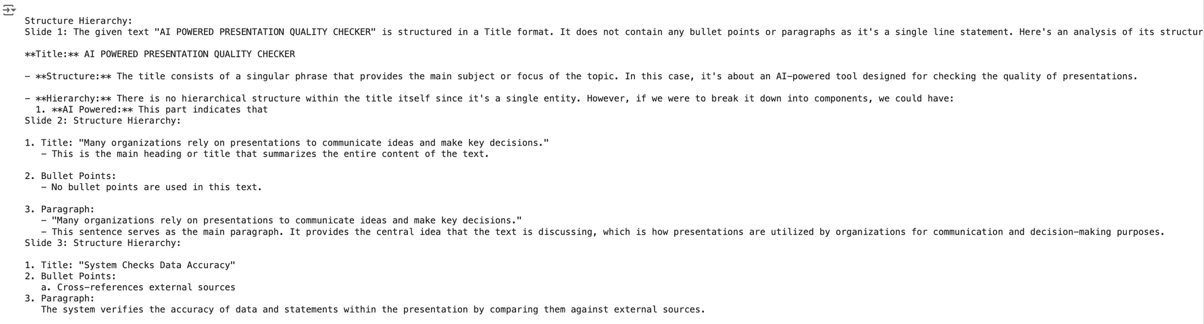
WHAT HAVE WE ACHIEVED YET ?
As you can see our model has clearly highlighted using bullet points, that currently it is not able to identify bullet points.

Slide 8
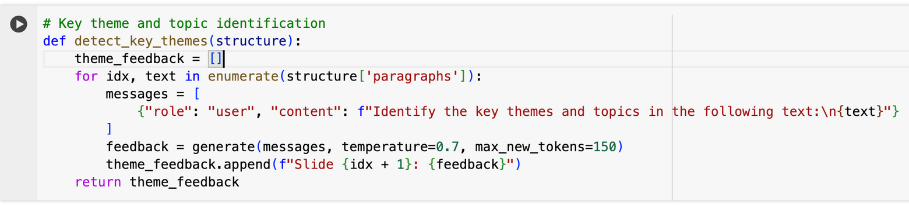
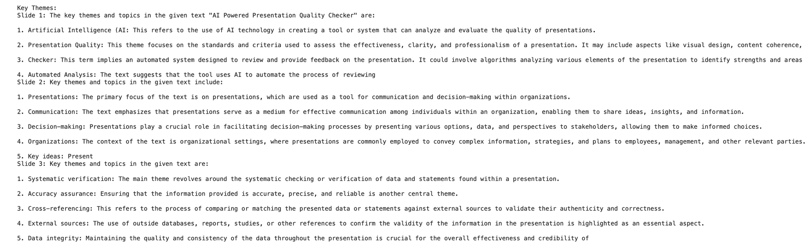
WHAT HAVE WE ACHIEVED YET ?
It does identify the theme, But the way we are getting the feedback seems suspicious now. It is confusing to all of us, including our model.

Slide 9
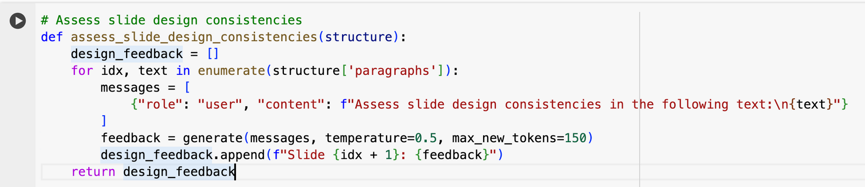
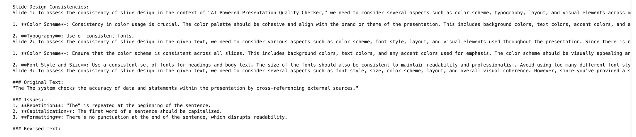
WHAT HAVE WE ACHIEVED YET ?
Colour was nor passed, neither can our model see it, So it lets us know how crucial colour is in our life.

Slide 10
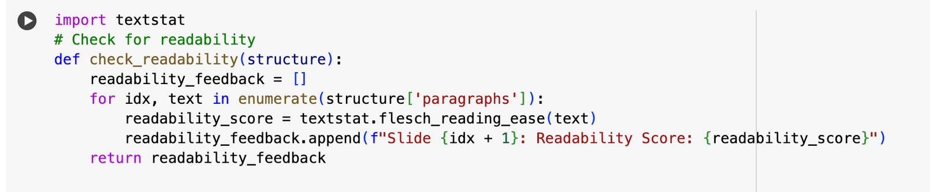
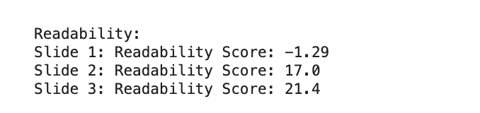
WHAT HAVE WE ACHIEVED YET ?
We understand our error now - Instead of Titles, Bullet Points and Paragraph - Our code prints Slide 1, Slide 2, Slide 3. Readability and Understandability both took a hit today.

Slide 11
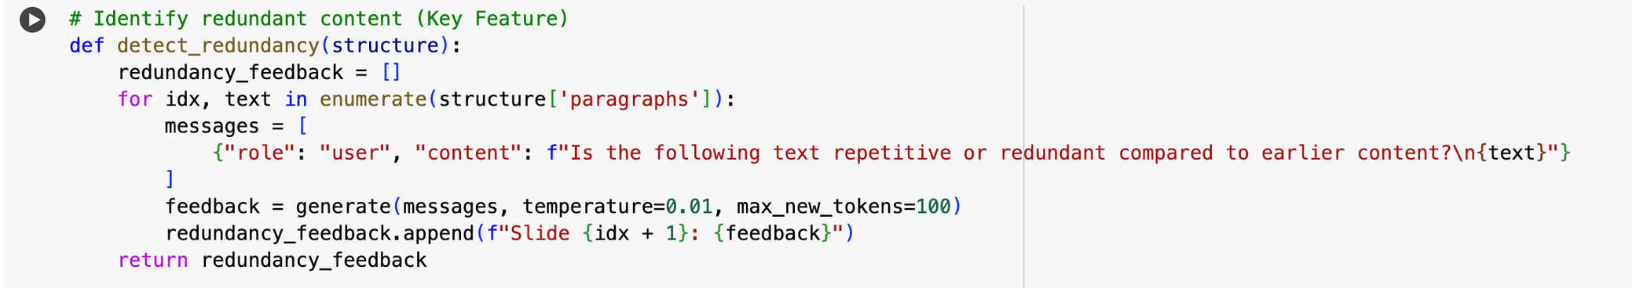
WHAT HAVE WE ACHIEVED YET ?
SOMETHING WORKS!!!!
STOP LAUGHING

Slide 12


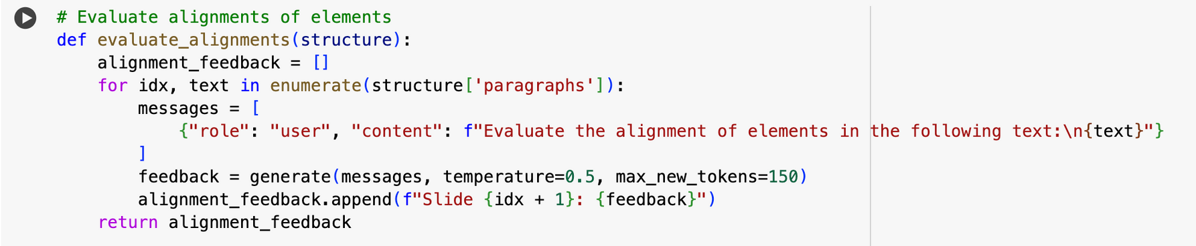
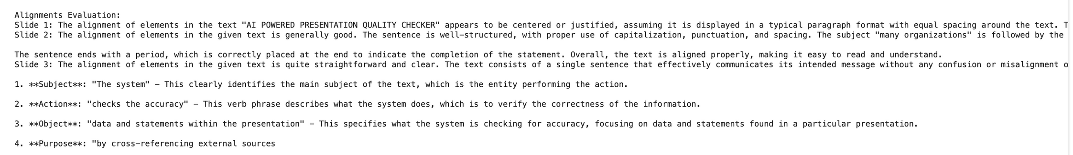
WHAT HAVE WE ACHIEVED YET ?
TWO THINGS WORK, VIDIT IN YOUR FACE

Slide 13

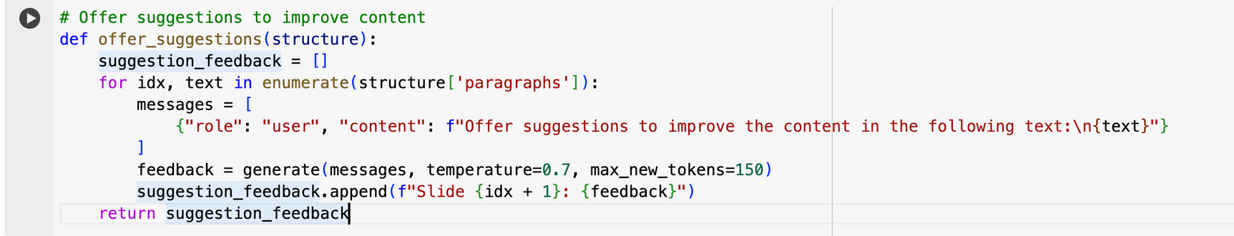
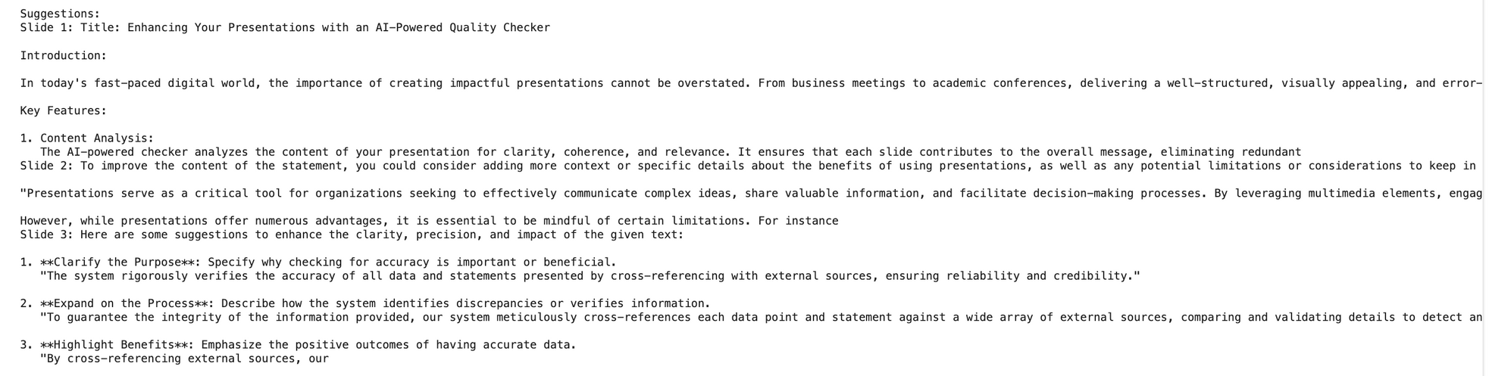
WHAT HAVE WE ACHIEVED YET ?
It does offer suggestions, we are just not smart enough to understand it.

Slide 14
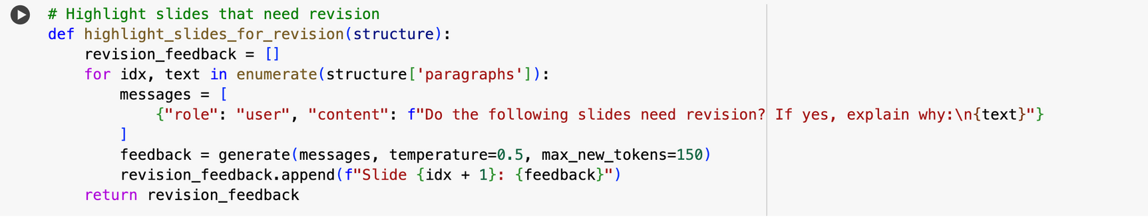
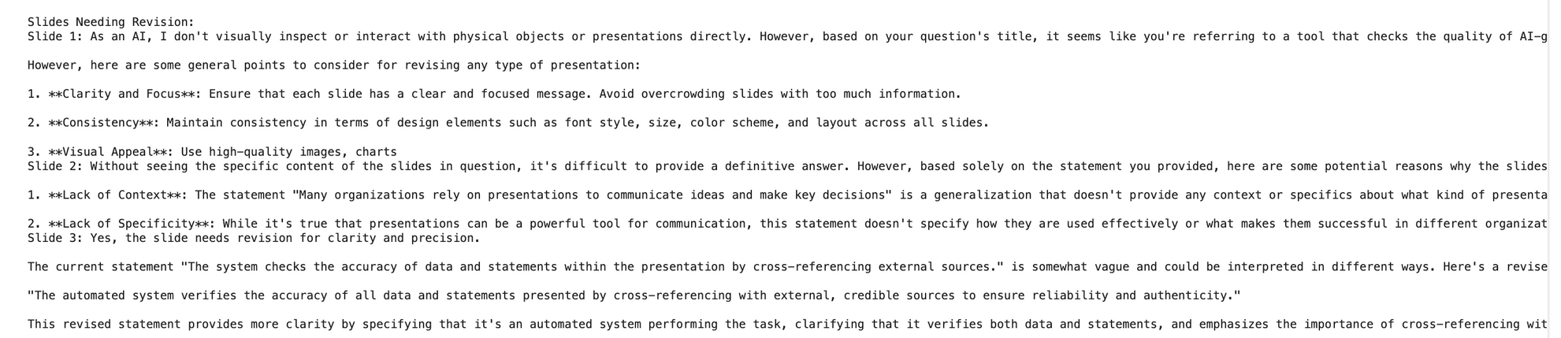
WHAT HAVE WE ACHIEVED YET ?
Since, It can’t see our slides, we will be assuming we don’t need any revisions, and thus completely ignoring the general points given.

Slide 15
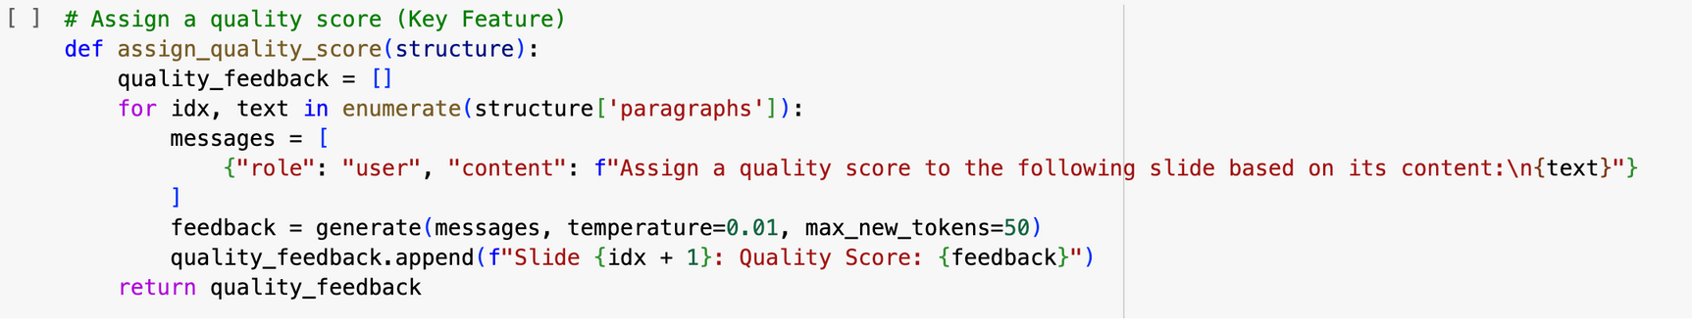
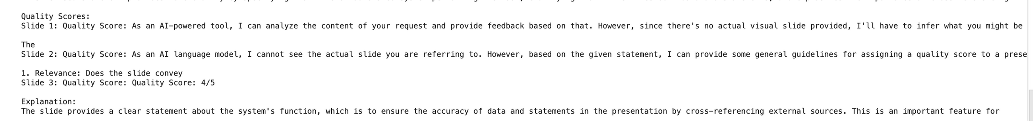
WHAT HAVE WE ACHIEVED YET ?
Our Model knew we were sad, Maybe that is why we got 4/5.

Slide 16

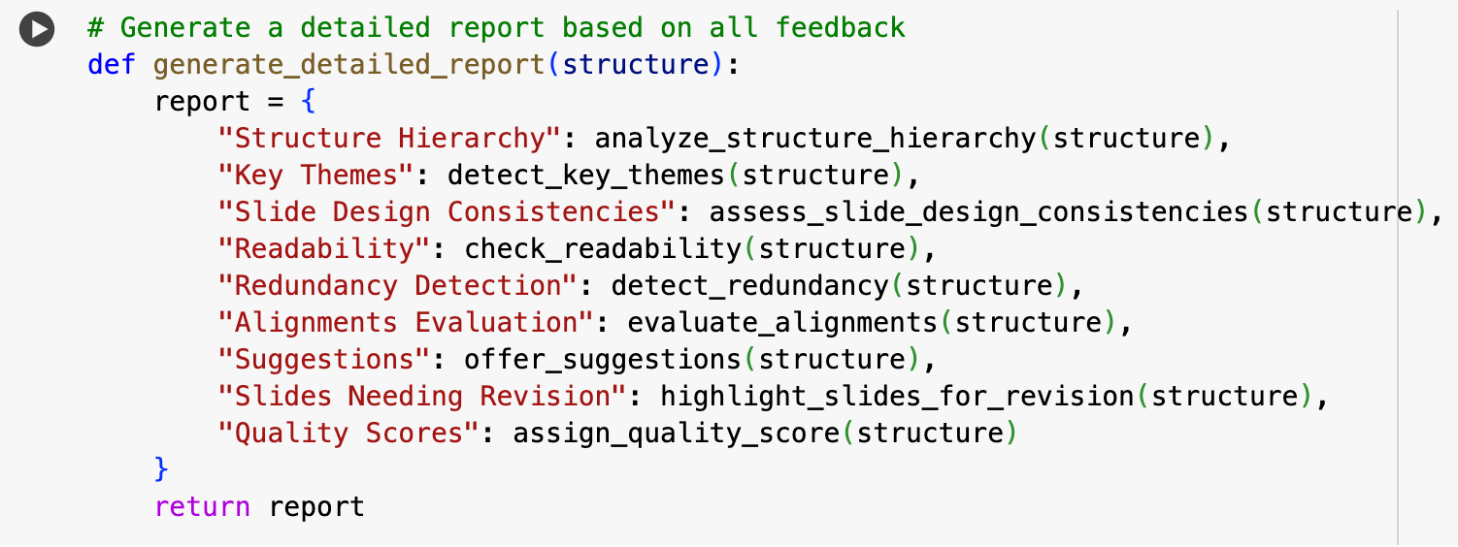
WHAT HAVE WE ACHIEVED YET ?
Detailed report just gives us all the disappointments together.

Slide 17


AREAS OF IMPROVEMENT
GO TO FEATURE ONE AND START FROM THERE, NOT ENOUGH SPACE TO ACCOMODATE EVERYTHING.

Slide 18

THANK YOU

